Slide 1
Do Now
How do the earth’s lithospheric plates move?
What types of land formations occur from plate movement?
Have we ever seen part of the Mantle?
RIDDLE: Rough and gray as rock,
I'm plain as plain can be.
But hidden deep inside there's great beauty in me. What am I?

Slide 2
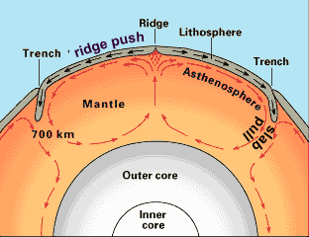
Why do Plates Move?
Mantle convection currents
Slab pull – cold dense plates sink and pull the rest of the plate down at a trench
Ridge push – plates are pushed due to the force of gravity at a ridge

Slide 3
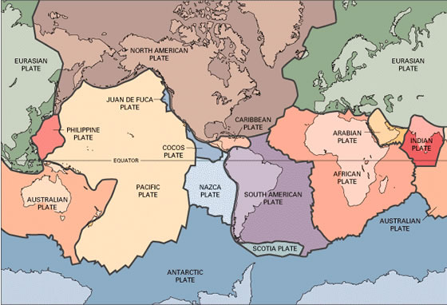
What is a plate boundary?
A plate boundary is the border between two plates.

Slide 4
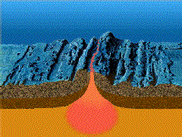
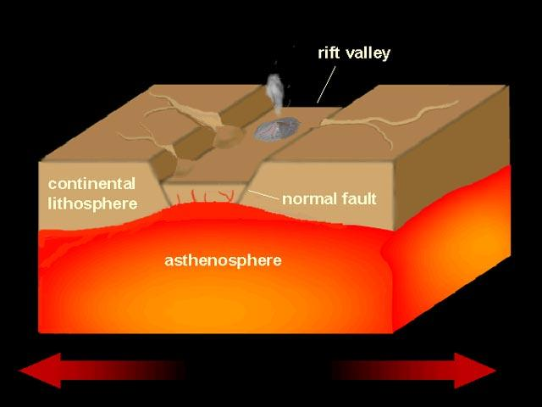
Divergent Boundaries – Create lithosphere
Plates spread apart and mantle material fills gaps
Oceanic Ridges: New mantle material rises and elevates the seafloor.
Rift Valleys: Deep faults where plates pull apart

Slide 5
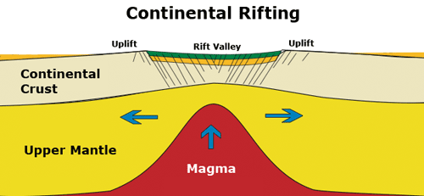
Divergent Boundaries
Continental rifts: Landmass splits into two smaller segments

Slide 6
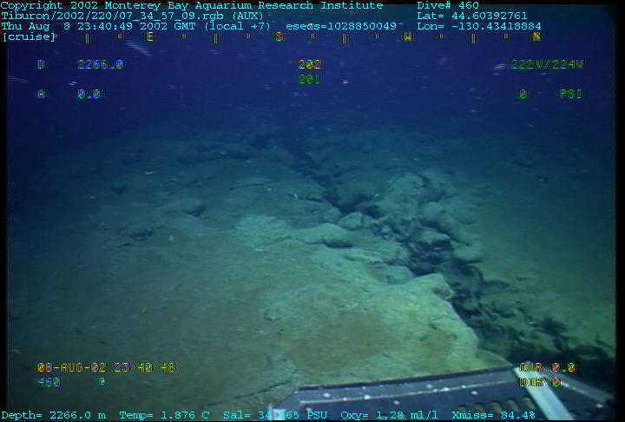
Mid-Atlantic Ridge

Slide 7
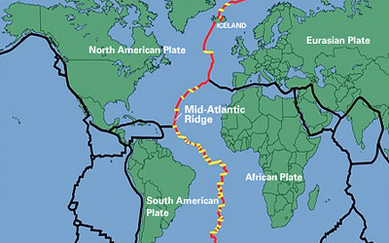
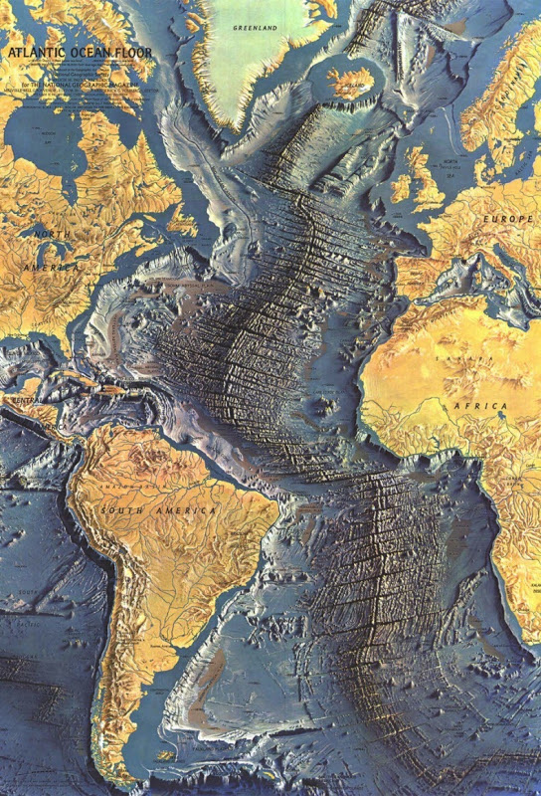
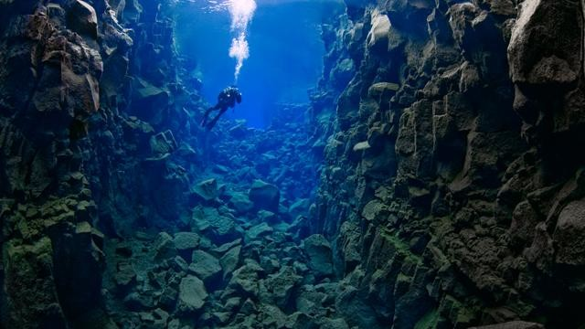
Mid-Atlantic Ridge

Slide 8
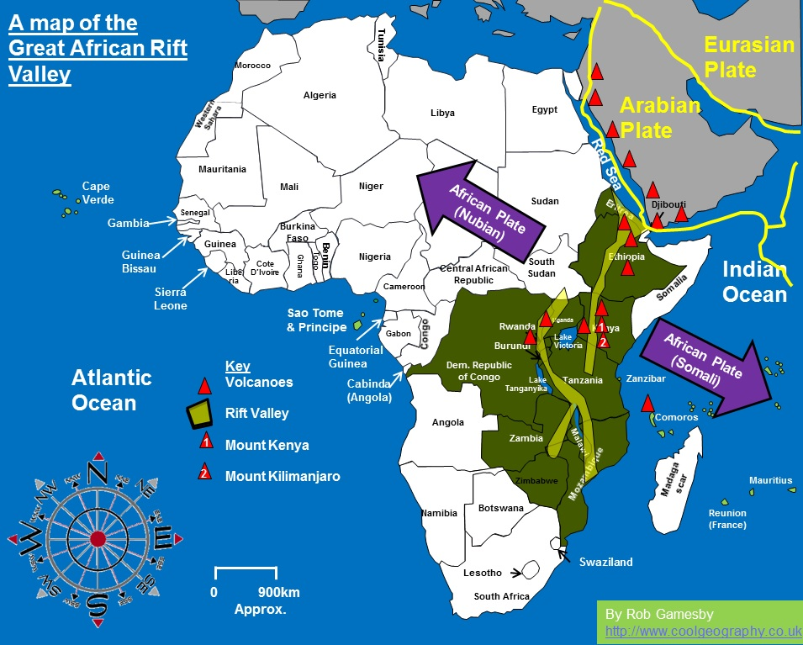
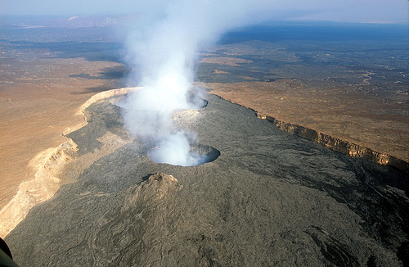
Continental Rift East African Rift Valley

Slide 9
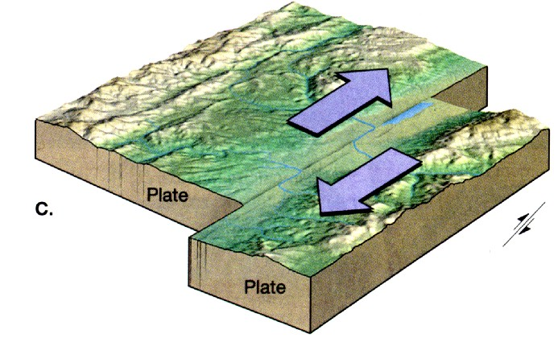
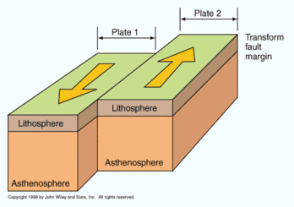
Transform Fault Boundaries
Plates grind past each other without destroying or creating lithosphere.
Earthquakes!

Slide 10
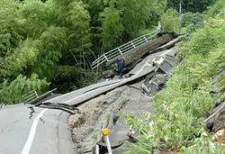
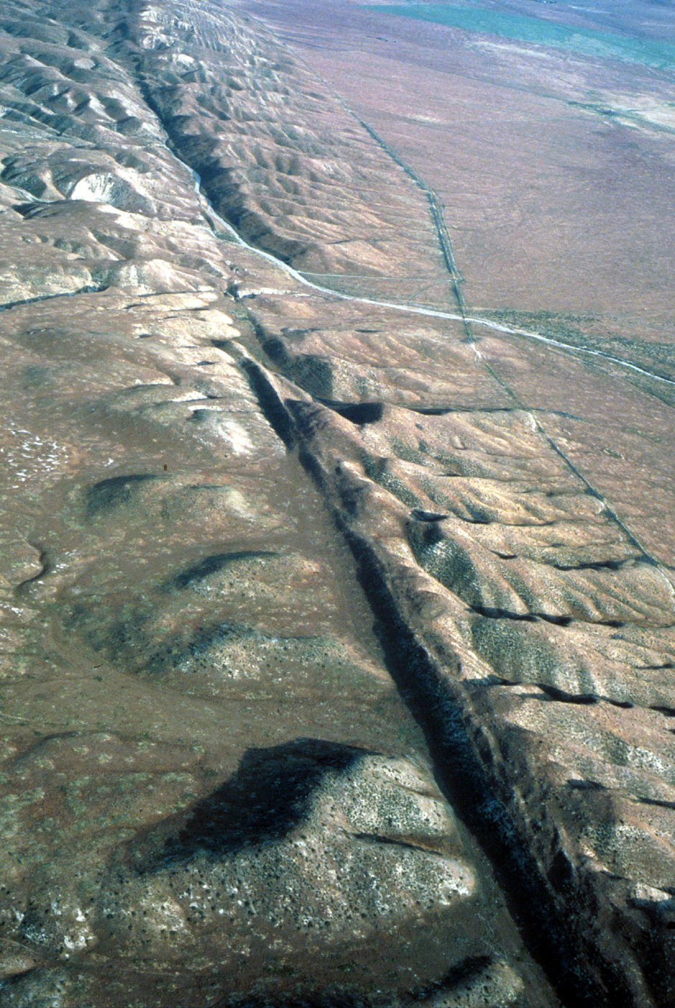

Slide 11
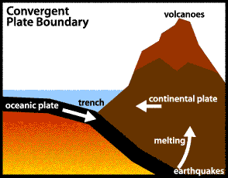
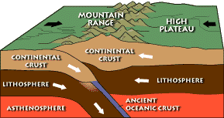
Convergent Plate Boundaries
A boundary in which two plates move together
Ocean-continent
Boundaries create trenches and volcanoes
Continent-continent
Boundaries create mountains

Slide 12
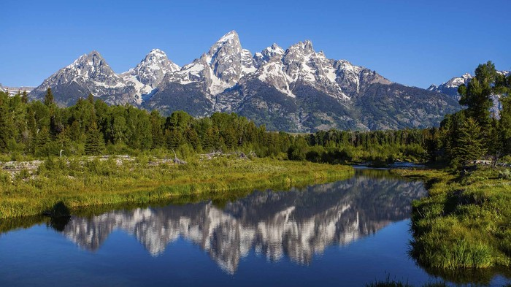
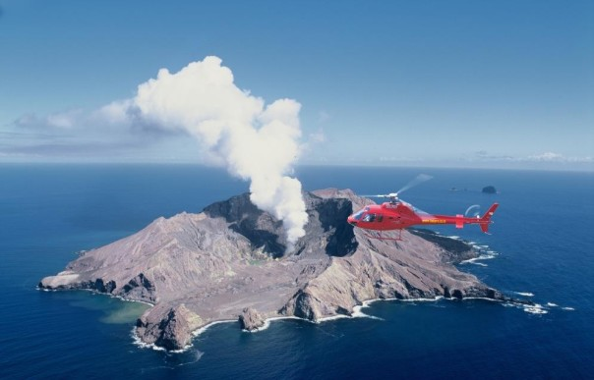
Which plate is LESS dense? Oceanic or Continental???
http://geology.com/nsta/

Slide 14
Exit Ticket
Answer the following in your notebooks:
Which types of plate boundary actions destroy lithosphere?
Which types of plate boundary actions create lithosphere?
Which types of plate boundary actions neither create nor destroy lithosphere?
How are mountains formed?

